Slide 1
Finding the optimal location for a new Vegetarian restaurant in St. Petersburg
Capstone Project
Kusheverskaia Maria

Slide 2
Finding the optimal location of a new restaurant is an important business task:
Vegetarian food is becoming increasingly popular and there are not many restaurants offering specialty food
In St. Petersburg a large number of restaurants but few vegetarian options
Finding the optimal location will allow stakeholders to develop their business in a less competitive environment

Slide 3
Data:
Based on definition of the problem, factors that will influence my decision are:
number of existing restaurants in the neighborhood (any type of restaurant)
number and distance to Vegeterian restaurants in the neighborhood, if any distance of neighborhood from the city center
Following data sources will be needed to extract/generate the required information:
centers of candidate areas will be generated algorithmically and approximate addresses of centers of those areas will be obtained using Google Maps API reverse geocoding
number of restaurants and their type and location in every neighborhood will be obtained using Foursquare API
coordinate of Saint Petersburg center will be obtained using Google Maps API geocoding of well known St. Petersburg location (Palace Square Ensemble and Hermitage)
364 candidate neighborhood centers generated.

Slide 4
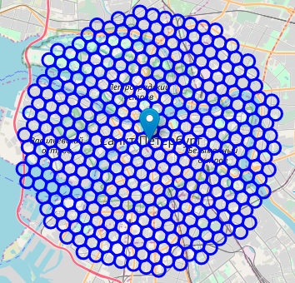
364 candidate neighborhood centers generated
Coordinates of centers of neighborhoods/areas, equally spaced (distance from every point to it's neighbors is exactly the same) and within ~6km from Palace Square.
Google Maps API were used to get approximate addresses of those locations
city center location and candidate neighborhood centers

Slide 5
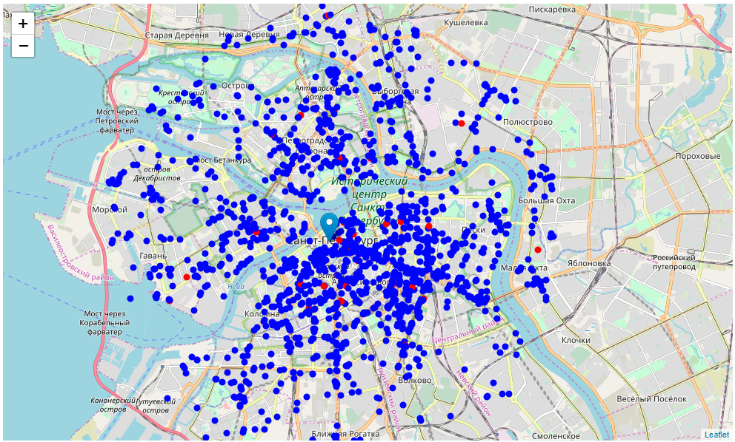
Foursquare
I'm interested in venues in 'food' category, but only those that are proper restaurants.
I will include in the list only venues that have 'restaurant' in category name, and will make sure to detect and include all the subcategories of specific 'Vegeterian restaurant' category, as I need info on Vegetarian restaurants in the neighborhood:
There are all the restaurants in area within few kilometers from Palace Square.
Red dots indicate vegetarian restaurants
Other restaurants are marked with blue dots

Slide 6
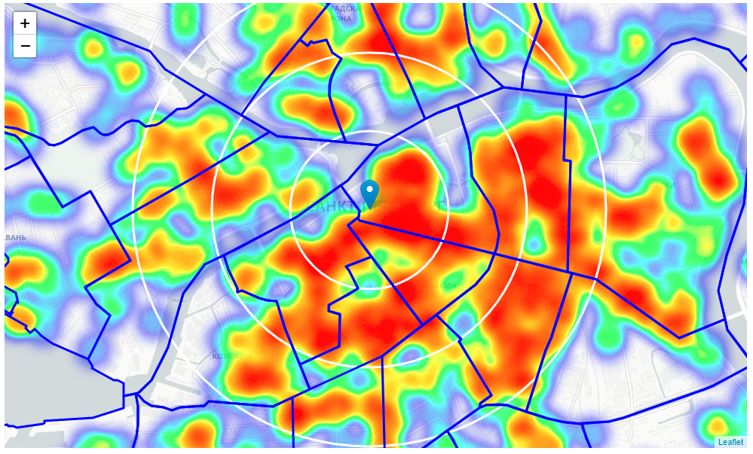
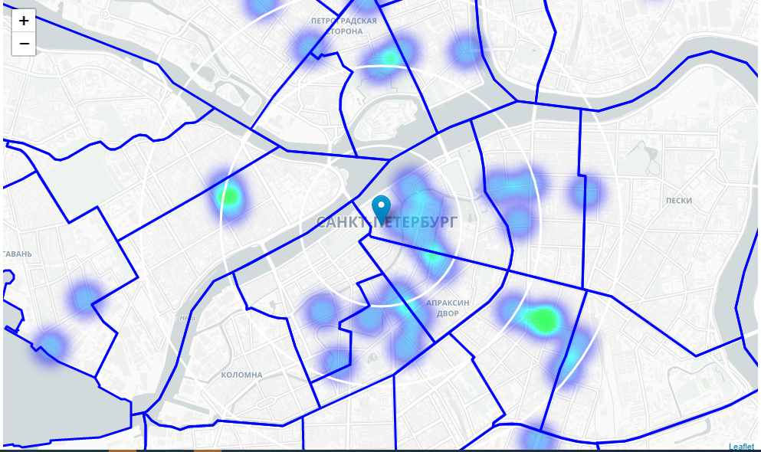
Heatmap/density of all restaurants
Heatmap/density of Vegeterian restaurants
Based on this I will now focus the analysis on areas North West and South West and West from St. Petersburg center - I will move the center of the area of interest and reduce it's size to have a radius of 2.5km. This places location candidates mostly in boroughs Kolomna and the Eastern part of Vasilievsky island

Slide 7
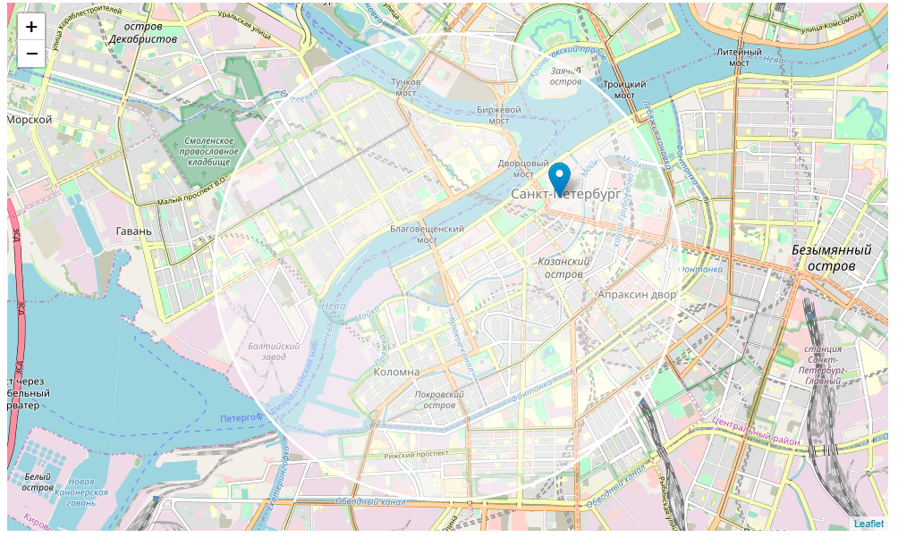
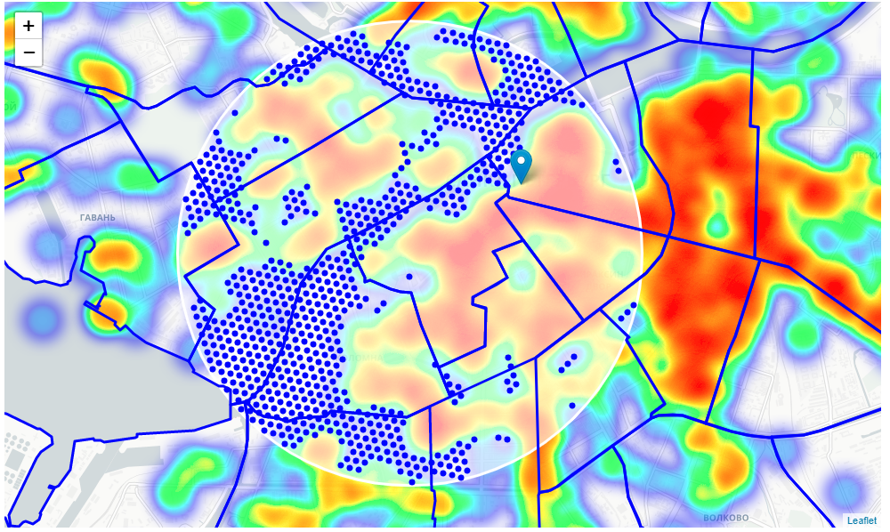
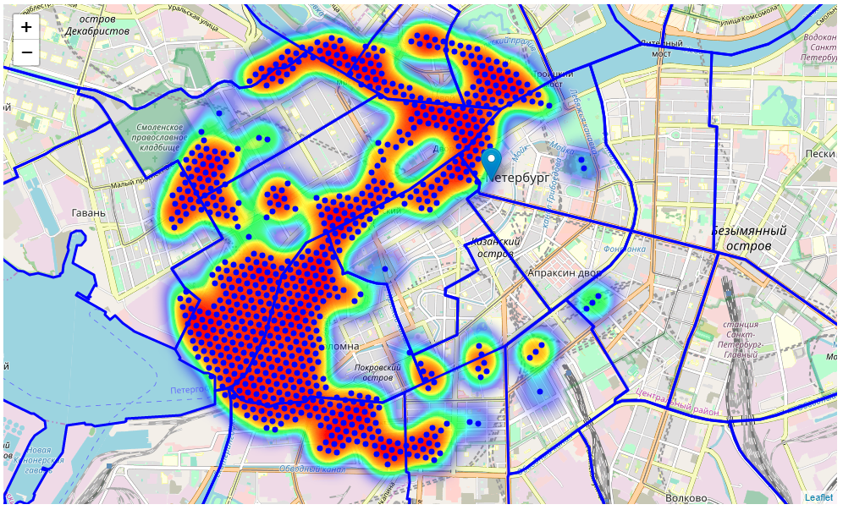
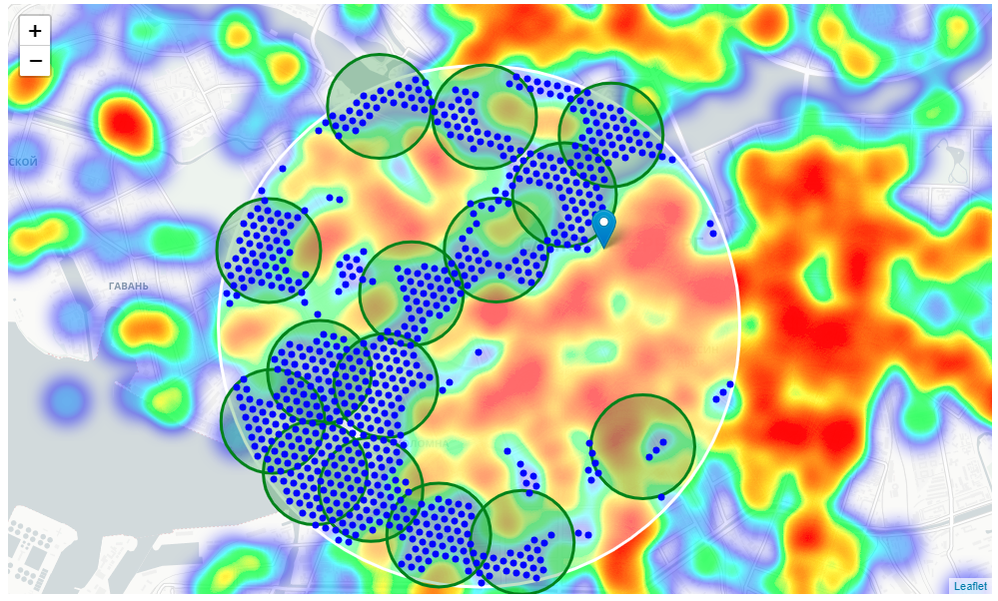
The clusters represent groupings of most of the candidate locations and cluster centers are placed nicely in the middle of the zones 'rich' with location candidates.
Addresses of those cluster centers will be a good starting point for exploring the neighborhoods to find the best possible location based on neighborhood specifics.

Slide 8
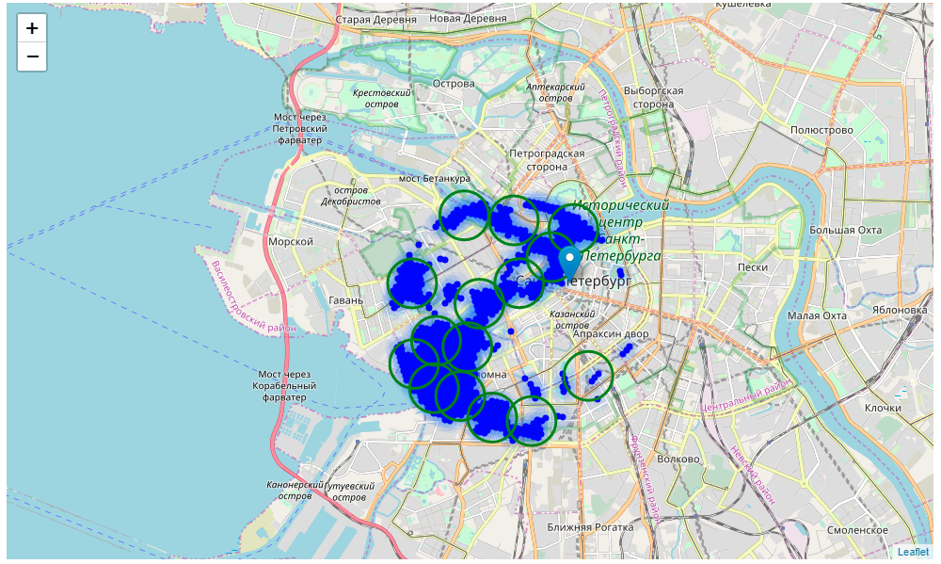
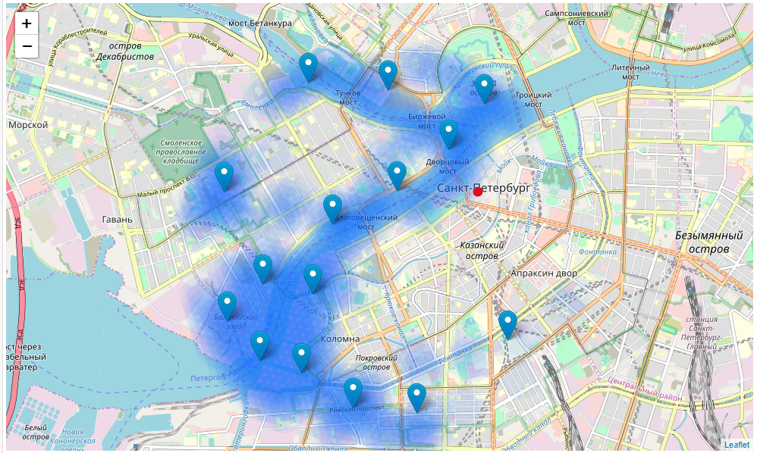
Final candidate areas
15 addresses representing centers of zones containing locations with low number of restaurants and no Vegeterian restaurants nearby, all zones being fairly close to city center (all less than 4km from Palace Square, and about half of those less than 2km from Palace Square).

Slide 9
Conclusion
By calculating restaurant density distribution from Foursquare data I have first identified general boroughs that justify further analysis (Kolomna and Vasilievsky island), and then generated extensive collection of locations which satisfy some basic requirements regarding existing nearby restaurants.
Clustering of those locations was then performed in order to create major zones of interest (containing greatest number of potential locations) and addresses of those zone centers were created to be used as starting points for final exploration by stakeholders.
Result of all this is 15 zones containing largest number of potential new restaurant locations based on number of and distance to existing venues - both restaurants in general and Vegeterian restaurants particularly.

